Slide 1

Exploratory Data Analysis
Pink/Yellow Cab
LISUM12
21/08/2022

Slide 2
G2M Use Case (Pink/Yellow Cab)
Problem :
The XYZ is a private firm in US. Due to remarkable growth in the Cab Industry in last few years and multiple key players in the market, it is planning for an investment in Cab industry following the “Go-to-Market(G2M)” strategy.
Goal :
Our goal is to help them to understand the market before taking final decision.
Work process :
Executive Summary
Problem Statement
Approach
EDA
EDA Summary
Recommendations

Slide 3
Data File Description
In this use case we will work with 4 csv files, the data was gathered from 31/01/2016 to 31/12/2018:
Cab_Data.csv : This file includes details of transaction for 2 cab companies.
Customer_ID.csv : This is a mapping table that contains a unique identifier which links the customer’s demographic details.
Transaction_ID.csv : This is a mapping table that contains transaction to customer mapping and payment mode.
City.csv : This file contains list of US cities, their population and number of cab users.

Slide 4
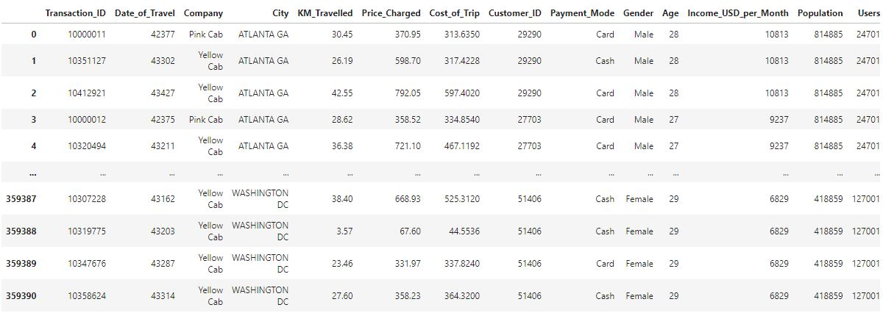
Exploratory Data Analysis
After merging the 4 csv data files, converting values for some features and ensuring of the absence of missing values we get the following data frame called Master_Data .

Slide 5
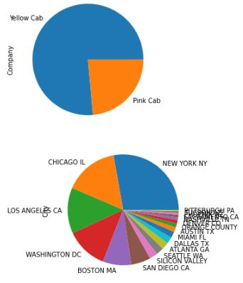
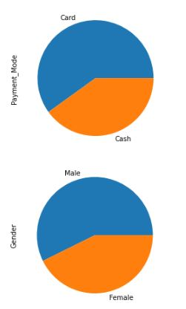
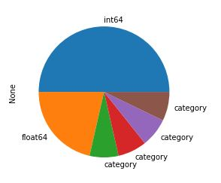
Exploratory Data Analysis
The following pie plot represent the different
percentage of values taken by each qualitative variable and the percentage of types utilized.

Slide 6
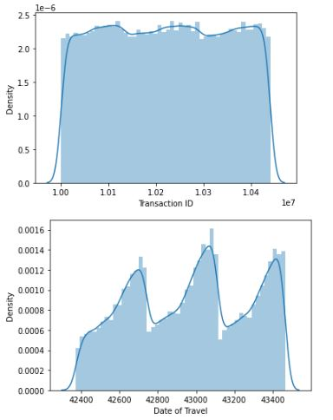
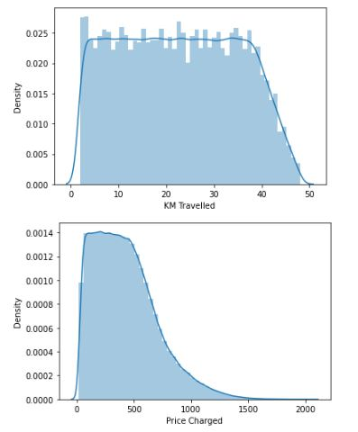
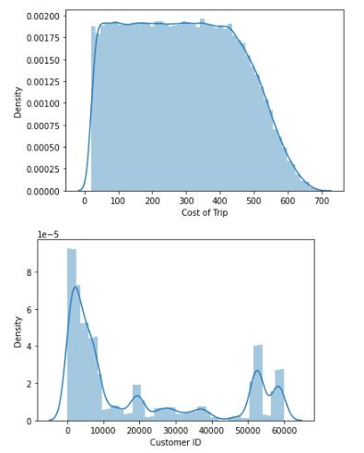
Exploratory Data Analysis

Slide 7
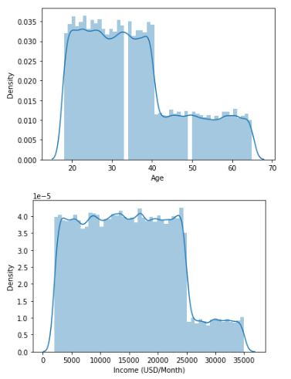
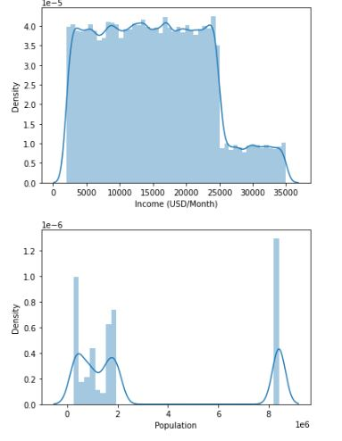
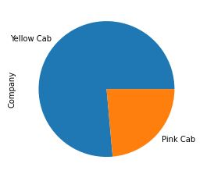
Exploratory Data Analysis
From this pie we can see that the Yellow Cab is higher than the Pink Cab.
From those histograms we can say that some values are symmetric , other are asymmetric ( skewed to the left).

Slide 8
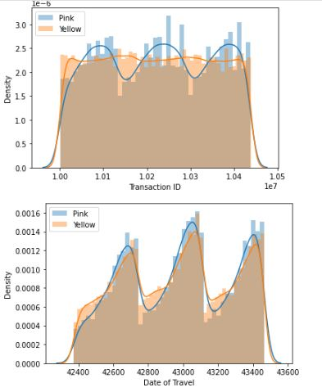
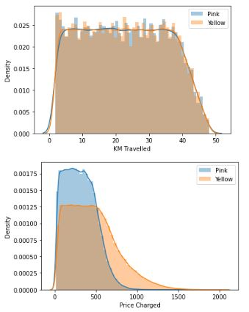
Exploratory Data Analysis

Slide 9
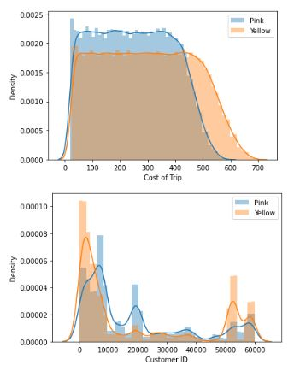
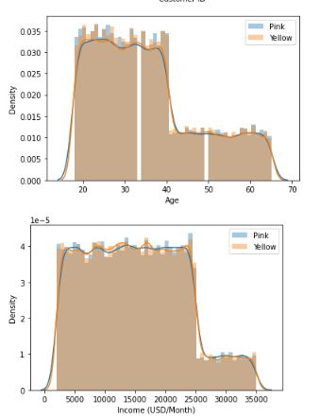
Exploratory Data Analysis
Those histograms visualize the relation between the numerical variables and the target

Slide 10
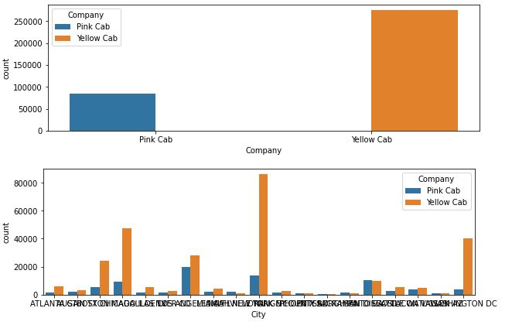
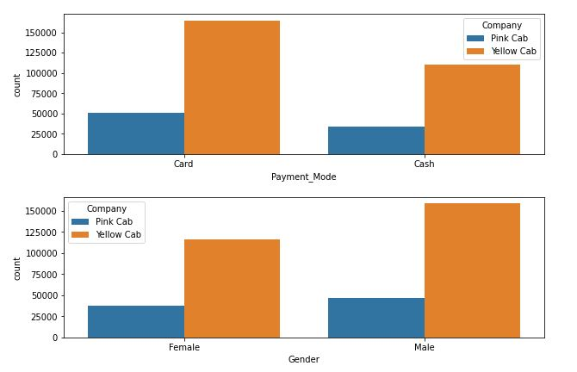
Exploratory Data Analysis

Slide 11
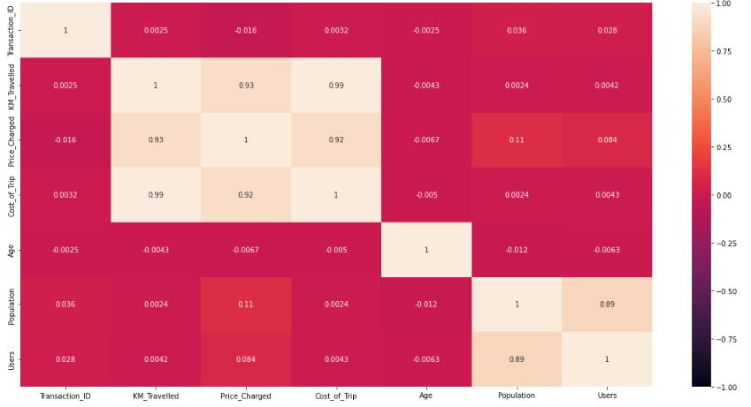
Pink Cab Correlation

Slide 12
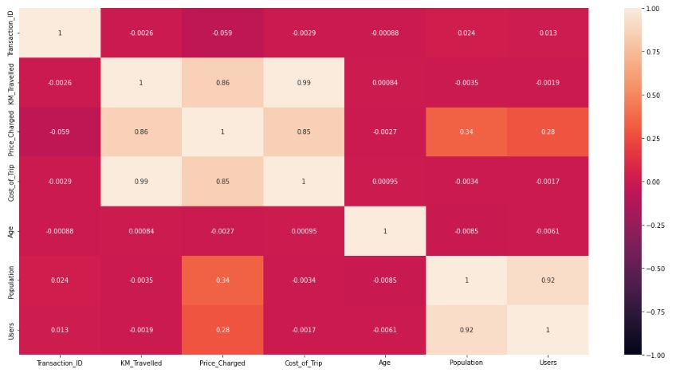
Yellow Cab Correlation

Slide 13
From the previous correlation tables we can notice that there is a high correlation between the following features:
KM_Travelled, Price Charged
KM_Travelled, Cost_of_Price
Price_Charged, Cost_of_Trp
Users, Population
From the previous plots we can see that :
More customer who use the two mode of payment are reserved for the yellow cab
Also the number of female who utilize the yellow cab are greater than those who utilize the pink one. Same thing for man.
We can see that yellow cab is widely used in all cities but the pink cab is probably restricted to some cities as shown on the previous figure .

Slide 14

G2M Cab
Thank You

